Slide 1

Nolwenn M. Dheilly Assistant Professor
THE PARASITE MICROBIOME PROJECT
Notes:
Before I start, I would like to thank you for your invitation. Today, I will start by discussing why we need a parasite microbiome project. I will tell you briefly our objectives and will use current projects on to identify some of the challenges that we face, and potential new standards required for the purpose of this project

Slide 2
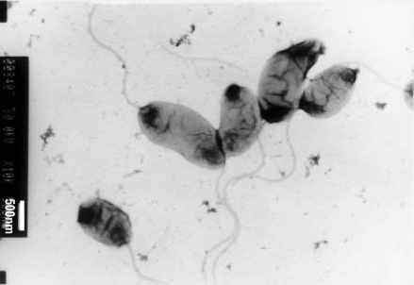
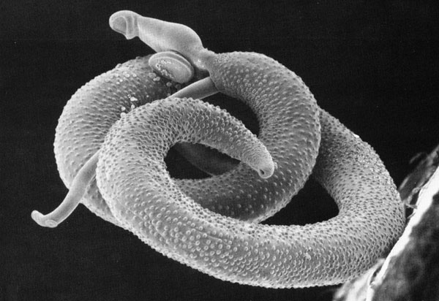
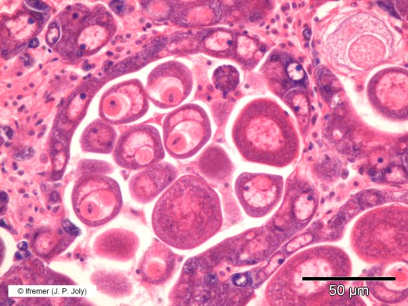
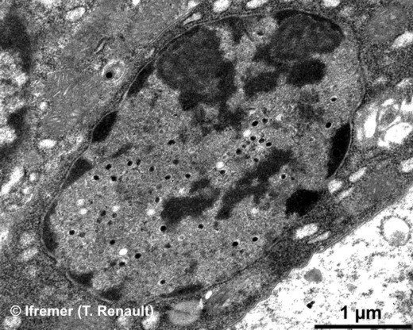
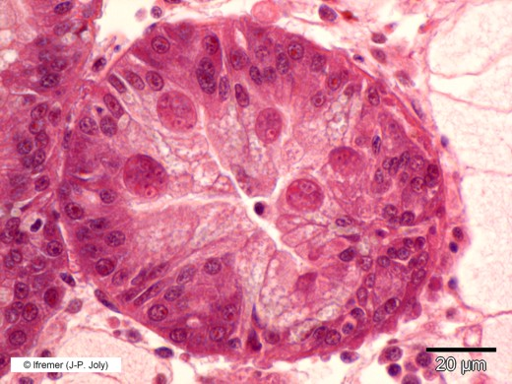
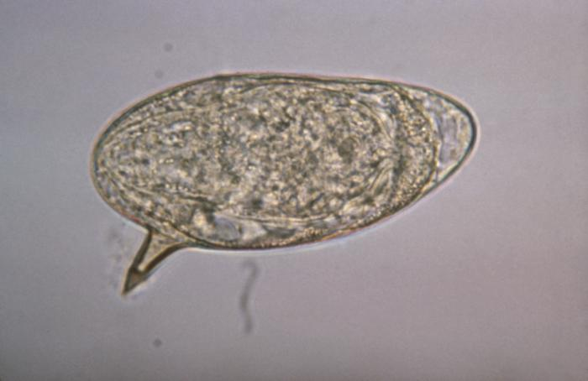
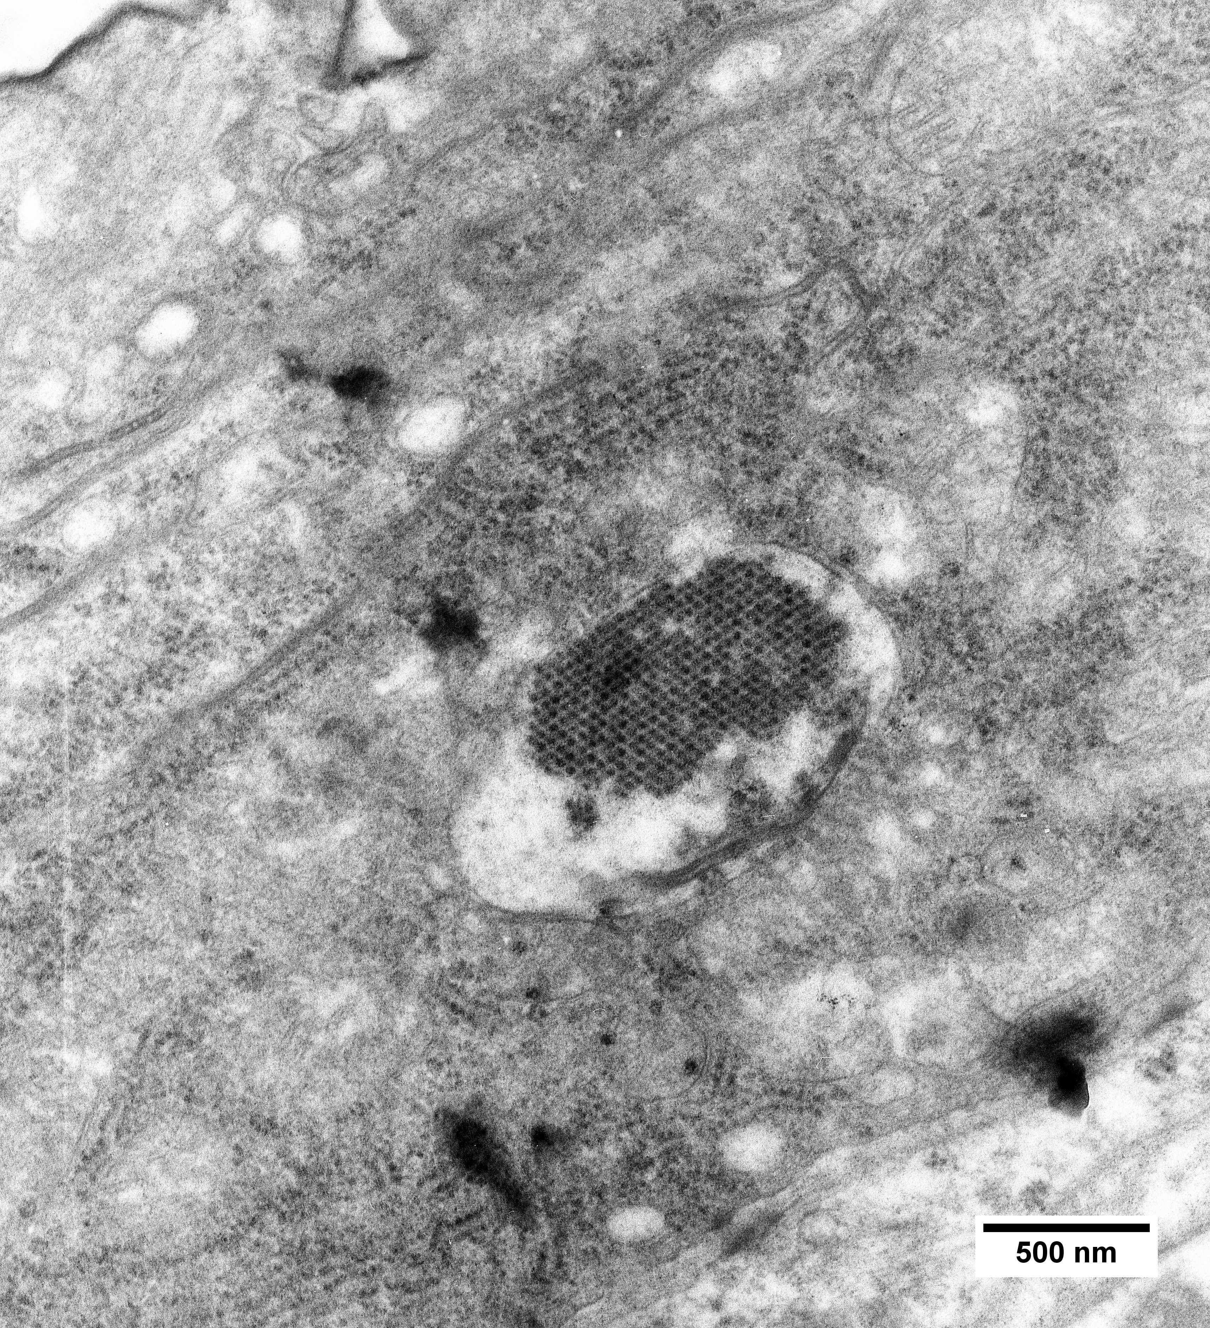
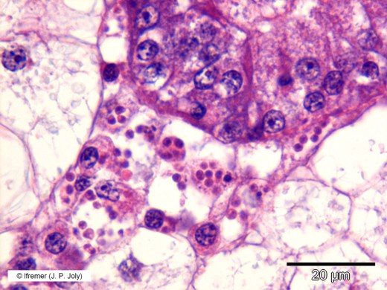
Parasites role in ecosystems
2EI
2EI
ifremer
ifremer
ifremer
2EI
ifremer
Notes:
But first, why do we care about parasites? Parasitism is not an anecdotic way of life. More than 80% of all known species are considered parasites, that is an organisms that live in or on another organism and benefits by deriving nutrients at the host expense. Parasites are of importance to human health, agriculture and aquaculture, but they also play major role in ecosystems. They regulate their host populations, affect their behavior, and make a major contribution to biodiversity. In fact, except for laboratory animals, every organism on earth is parasitized and multiparasitim is very common. In humans, as many as 30% of infections may be co-infections, and this rate can climb as high as 80% in certain populations.

Slide 3
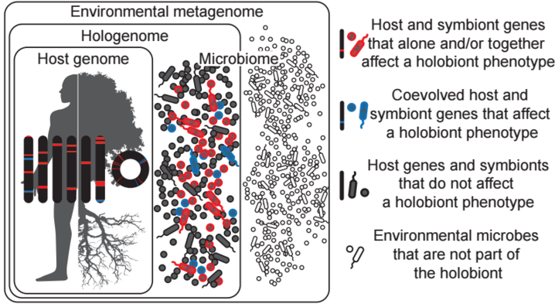
The holobiont
Theis, Dheilly et al., 2016
Notes:
There is now a growing recognition that we need to account for the role of microbes in health and diseases. The holobiont is defined as a host and all its associated microbes, including viruses, bacteria, fungi and protozoans. All microbes associated with an organism at a given time are part of the holobiont.

Slide 4
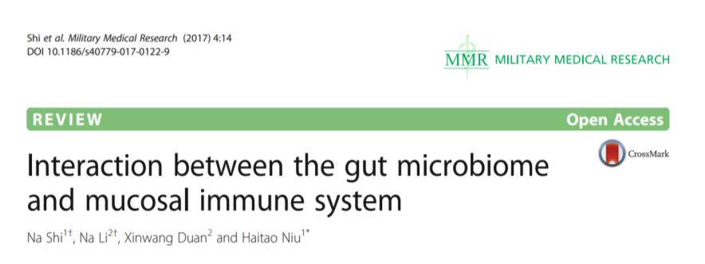
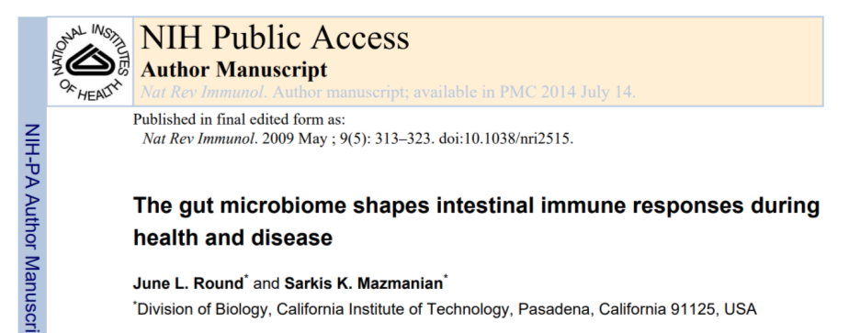
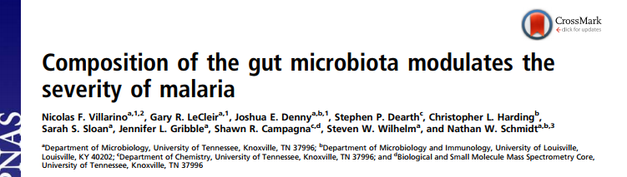
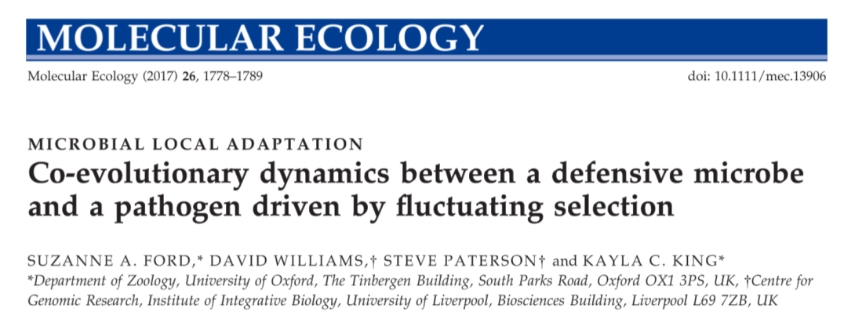
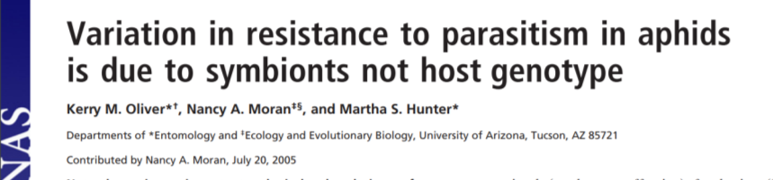
The holobiont host
Notes:
I think we are starting to get a pretty clear picture of the role of microbes associated with the host. We now know that the host microbiome is necessary for proper immune system maturation and for maintanence of a healthy immune system. Microbes can also more directly participate in defense against parasites by producing toxins directed against parasites or through competition for nutrients. They can even co-evolve directly with the parasites, in lieu of their hosts.

Slide 5
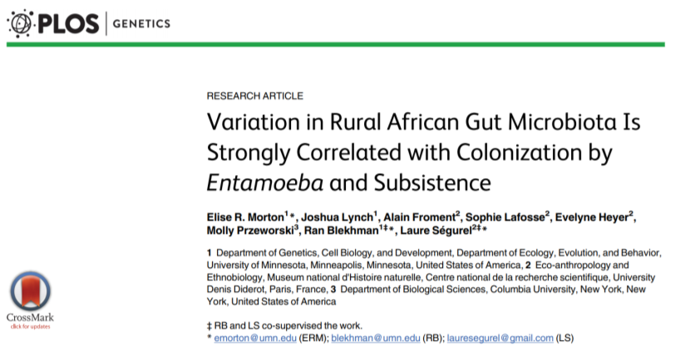
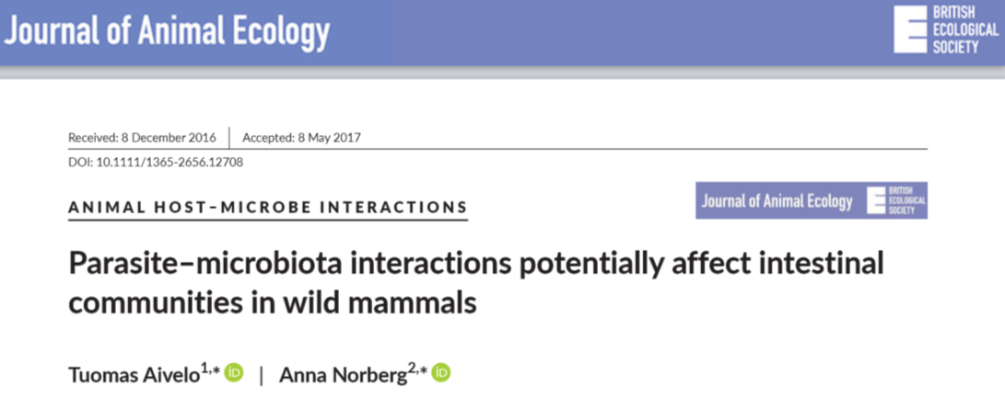
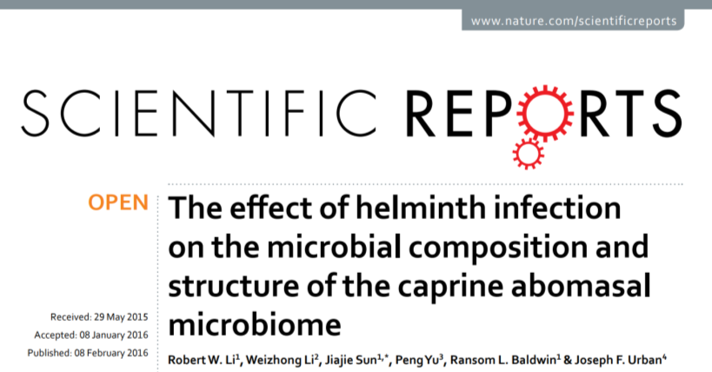
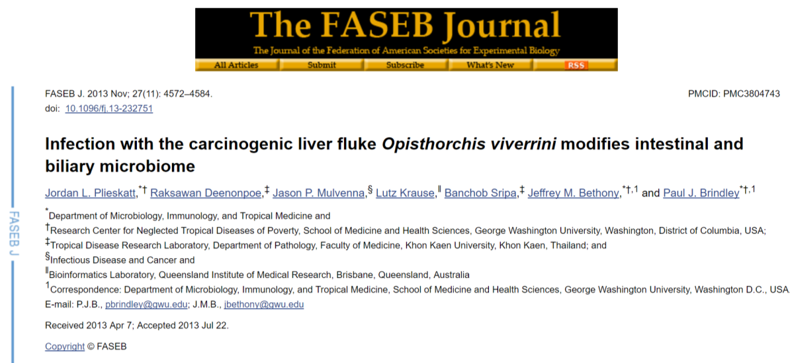
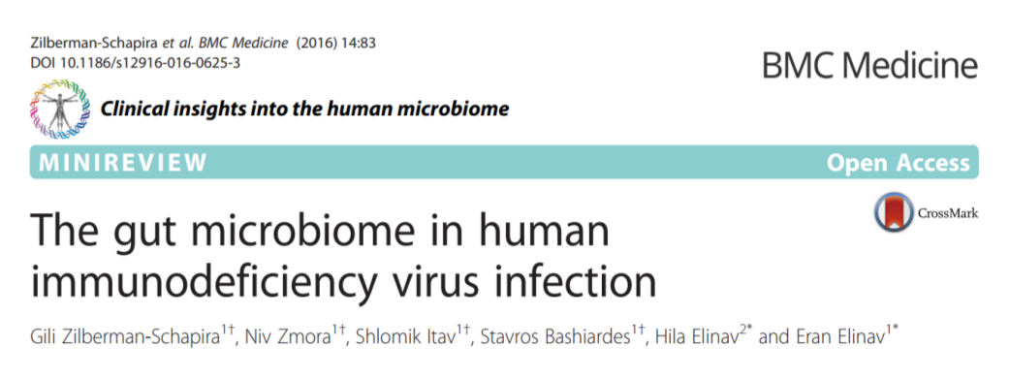
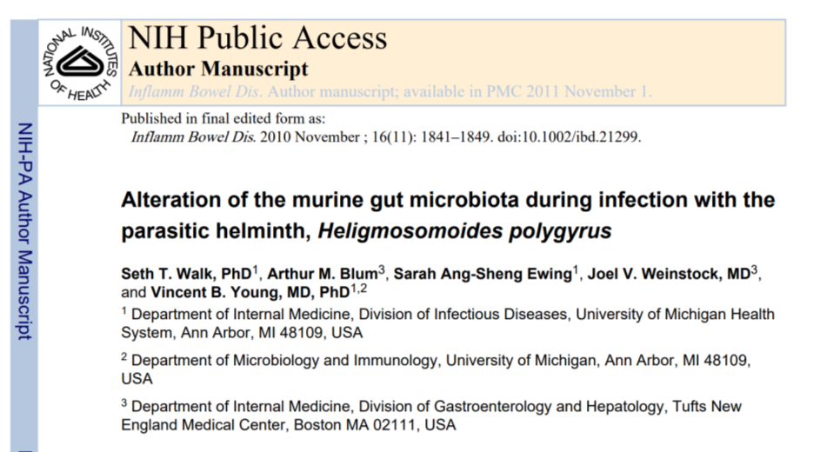
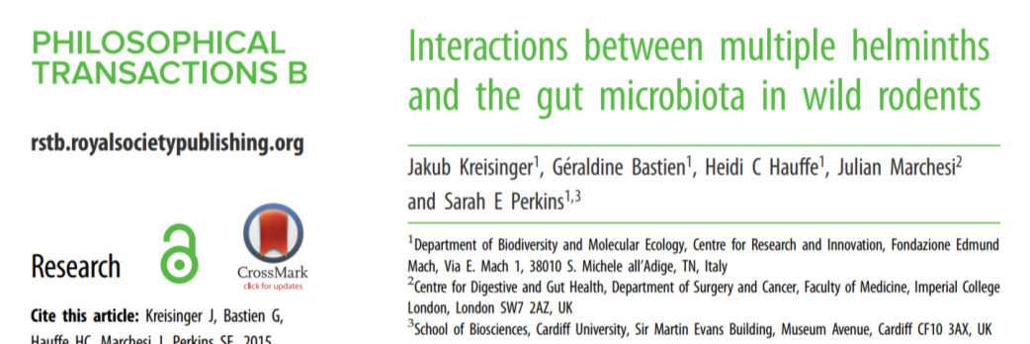
Parasite interaction with host-associated microbes
Notes:
Can parasite respond to this? Laboratory controlled and field experiments from various labs, and biological system have shown an alteration of the host microbiome during parasite infection. However, it is yet unknown whether this is part of a defense mechanism from the host, if this is beneficial for the parasite, or if it is merely a side effect of infection.

Slide 6
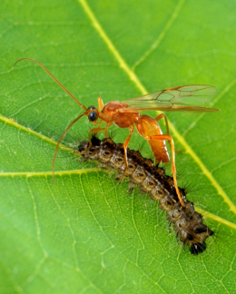
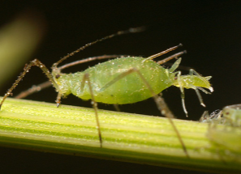
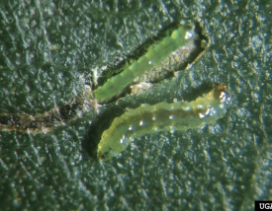
The holobiont Parasite
Insects
wikipedia
wikipedia
wikipedia
Bacteria in herbivorous insects
Sugio et al., 2015
Polydnaviruses in parasitoid wasps
Roossinck, 2011
Notes:
What about parasites? Can parasites be considered holobiont as well? Yes. Viruses and bacteria have been found in a range of different parasites. In particular in insects there are strong evidence for the beneficial role of bacteria, and viruses in the infection process.

Slide 7
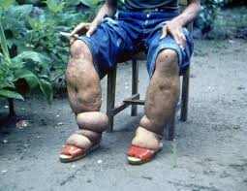
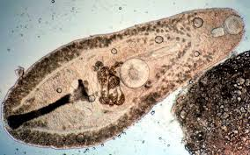
The holobiont Parasite
Helminthes
wikipedia
wikipedia
Wolbachia in filarial nematodes
Bandi et al., 1998
Neorickettsia in digenean trematodes
Vaughan et al., 2012
Notes:
Helminths, in particular nematodes and trematodes have long been known to carry bacteria. Wolbachia has high prevalence in nematodes and is responsible for many symptoms associated with severe diseases, such as elephantiasis shown on this picture, and Neorickettsia has high prevalence in digenean trematodes and can also cause numerous diseases such as salmon poisoning disease in dogs and Horse fever. However, most studies have focused on a single microbe of interest and the presence of other microbes is unknown.

Slide 8
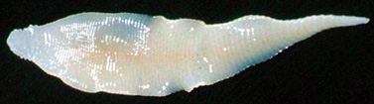
The holobiont Parasite
Helminthes
wikipedia
wikipedia
Wolbachia in filarial nematodes
Bandi et al., 1998
Neorickettsia in digenean trematodes
Vaughan et al., 2012
Bacteria and viruses in a Cestode
Hahn and Dheilly submitted.
Notes:
Until now, cestodes, that do not have a digestive system and develop in the body cavity of their host were considered sterile. But my PhD student Megan Hahn found a complex microbiome and two new species of negative strand RNA viruses in Schistocephalus solidus, suggesting that other cestodes may also carry a microbiome.

Slide 9
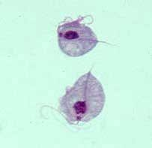
The holobiont Parasite
Protozoans
Trichomonas vaginalis
Vector of Mycoplasma hominis
Mycoplasma enhances Trichomonas cytopathogenicity
Trichomonavirus strains influence the severity of symptoms
wikipedia
Viruses in protozoan parasites
Wang and Wang, 1991; Fichorova et al., 2012; Ives et al., 2011
Antiparasitic drugs can cause dying parasites to release microbes, worsening the symptoms, which explain why treatments fail to prevent preterm birth
Fichorova et al., 2017; Margarita et al., 2016; Mercer et al., 2016
Notes:
In protozoans as well there as been multiple observations of virus like particles by electron microscopy. However, in most cases the viruses have not been characterized further. The microbiome of T. vaginalis is probably the best characterized. We now know that it is a vector of the bacteria Mycoplasma hominis, that causes sever bacterioses and enhances Trichomonas cytopathogenicity. It is also associated with a virus, called trichomonavirus and different strains result in different symptoms. Most importantly killing the parasite by using antiparasitic drugs releases the microbes, which can worsen the symptoms.

Slide 10
Horizontal transmission of microbes
Notes:
So one of the most important aspect of parasite microbiomes is the potential for horizontal transmission of microbes from the parasite to the host, and vice-versa

Slide 11
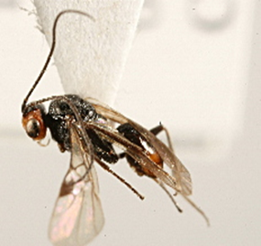
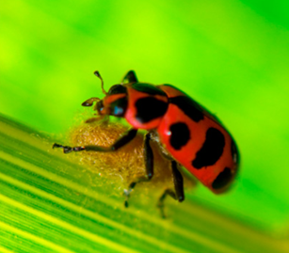
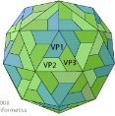
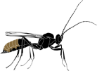
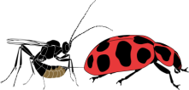
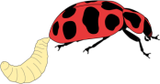

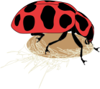
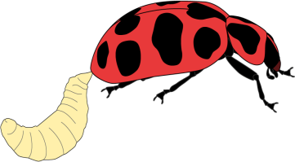
D. coccinellae and C. maculata
Parasitic wasp: Dinocampus coccinellae
Host: Coleomegilla maculata
The Dinocampus coccinellae Paralysis virus (DcPV)
Normal behavior
« Bodyguard » behavior
Recovery
Dheilly et al, 2015
Notes:
For example, I published in 2015 the disovery of the Dinocampus coccinellae Paralysis virus, a new rna virus associated with D. coccinellae. We showed that the virus is transmitted to the ladybeetle during the parasitoid larval growth. This neurotropic virus replicates in the ladybeetle nervous tissue and appears to be responsible for the behavioral manipulation. Infected ladybeetles protect the parasitoid larvae from predators by staying croutched, paralized, on top of the parasitoid cocoon. In this case, the virus seem to be used as a biological weapon by the parasite, and would therefore has a beneficial role.

Slide 12
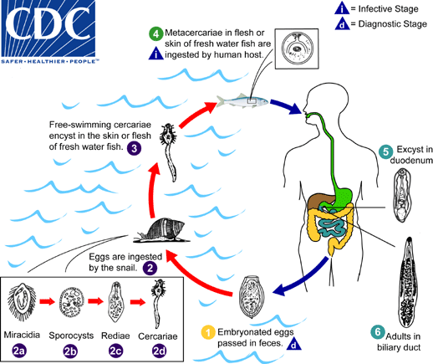
Opistorchis viverrini (Liver Fluke)
Notes:
The horizontal transmission of microbes to the host does not have to be beneficial to the parasite, and adaptative to be of interest to us.. O. viverrini is a good example. People get infected when consuming infected fish and infection is associated with very high risk of cholangiocarcinomes.

Slide 13
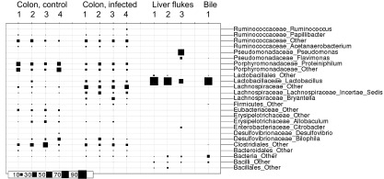
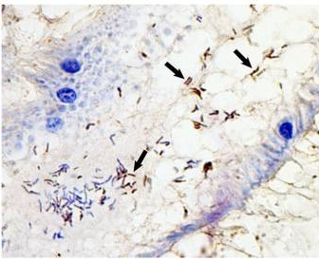
Opistorchis viverrini (Liver Fluke)
A reservoir for species of Helicobacter, including Helicobacter pylori
Infection results in changes in the gut microbiome composition
Plieskatt et al., 2013 ; Deenonpoe et al., 2015
Notes:
The microbiome of the liver fluke vary between individual parasites and infection is associated with a change in the gut microbiome of the host, and with the appearance of bacteria in the usually sterile bile. Also, further studies showed that O. viverrini can serve as a reservoir of the carcinogenic bacteria Helicobacter pylori.

Slide 14
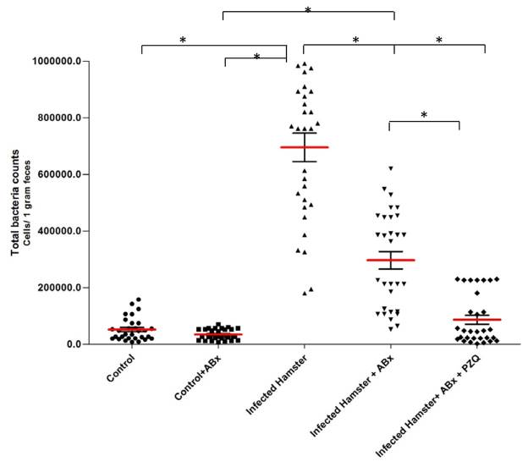
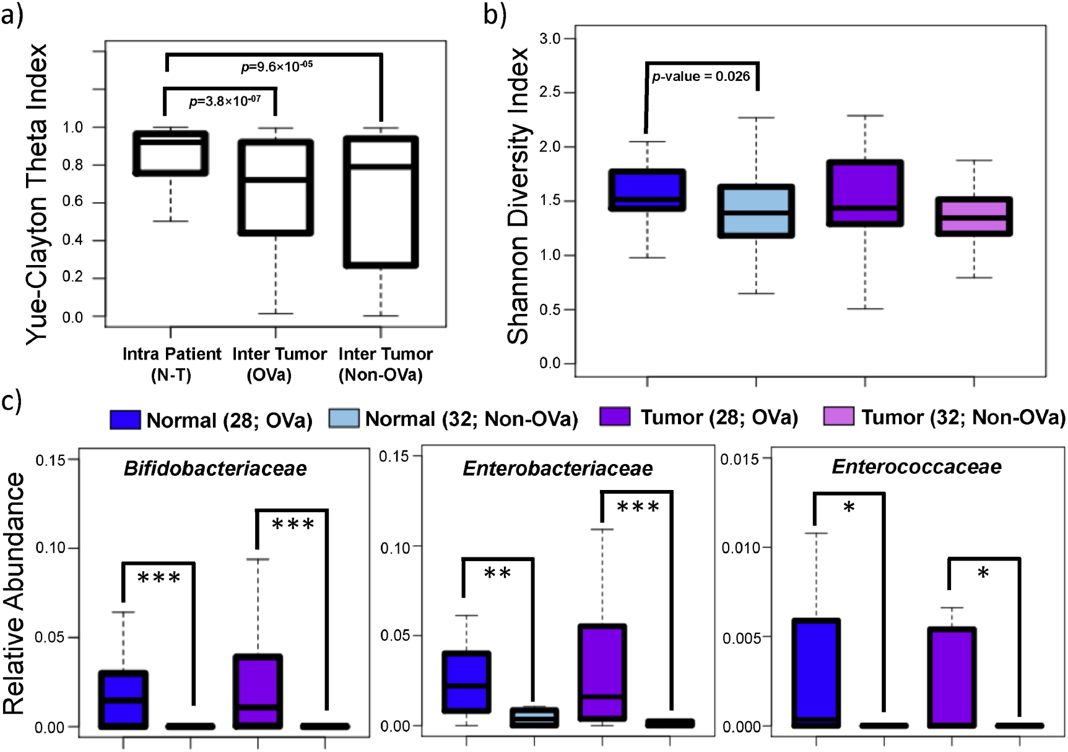
Opistorchis viverrini (Liver Fluke)
Parasite microbiome and cancer?
H. Pylori is significantly more abundant in the feces of hamsters infected by O. viverrini
Control Infected
3 families of bacteria are enriched in O. viverrini-associated Cholangiocarcinoma
Chng et al., 2016; Deenonpoe et al., 2015
Notes:
There is growing evidence that bacteria could be involved in the occurrence of cancer associated with this parasite. Indeed, the parasite serves as vector of the Helicobacter pylori, and an array of bacteria were found to be enriched in O. viverrini associated cholangiocarcinoma and in the liver of infected people. Characterizing microbes presence and transmission to the host is therefore relevant, even when the microbes are not beneficial, and symbiotic to their parasitic host.

Slide 15
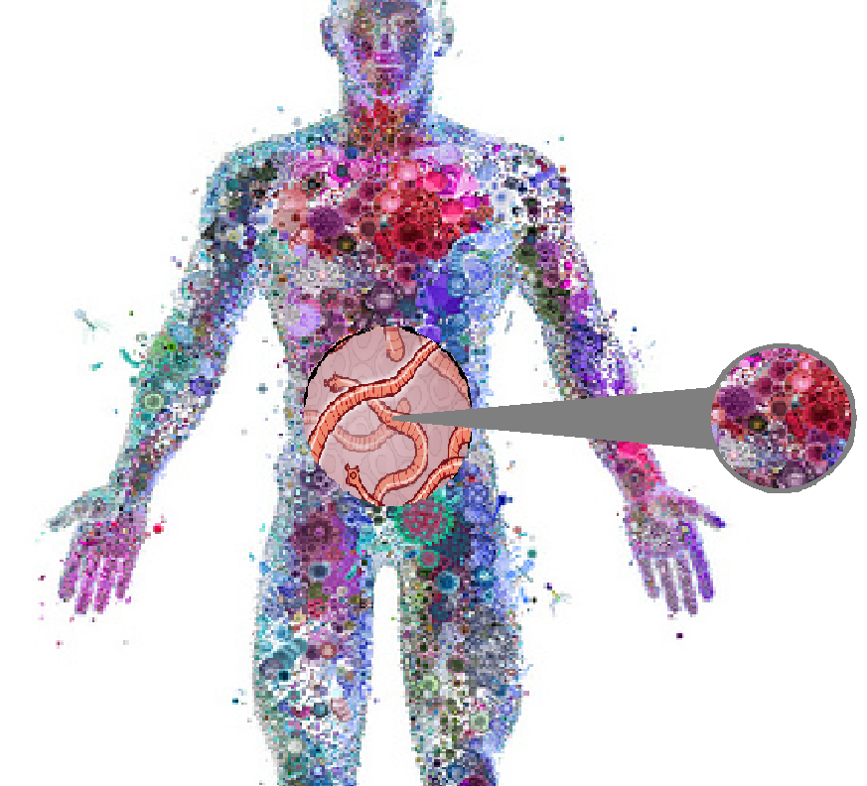
Holobiont-holobiont interactions: redefining host-parasite interactions
Any parasite may carry microbes
Microbes associated with parasites can be transmitted to the host
Parasites may acquire microbes from their hosts
Parasites may alter their host microbiome
→ Challenges Koch’s postulate
Modified from Charis Tsevis, Science News
Dheilly, 2015
Notes:
At this stage, I hope I have convinced you that any parasites may be associated with microbes and that they should not be considered as sterile. These microbes can be transmitted to the host during parasite growth, or upon parasite death, and affect the host phenotype.
This new realization of the role of microbes in host-parasite interaction is challenging the field of parasitology because it challenges Koch’s postulate that a disease is caused by a unique pathogen. It means that we do not know anymore what organism is responsible for which symptom, but it also offers new possibilities for the development of therapeutic strategies.

Slide 16
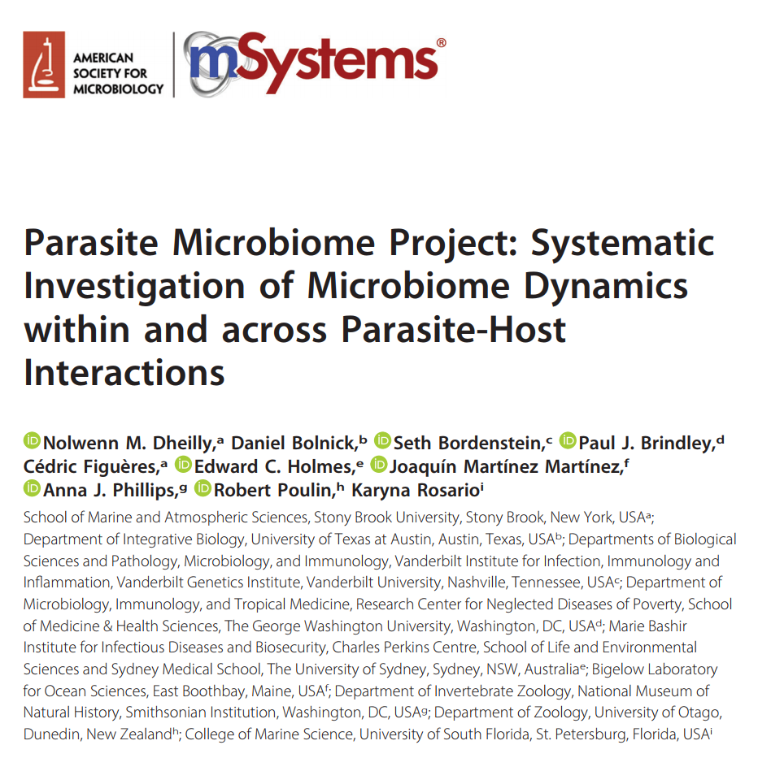
Characterization of the microbiome of parasites from various phyla
Assess the role of horizontal transmission of microbes among hosts and parasites in evolution
Characterize of the effect of parasites on their host microbiome
Notes:
Therefore, we propose to investigate the presence of bacteria and viruses within parasites and the effect of parasites on their host microbiomes across phyla to build an initial database of parasite microbiomes and identify parasite phyla for which the interaction with microbes is key to the infectious process, and could be the target for the development of new therapeutic strategies. Comparisons of host and parasite microbiomes, and of the microbiomes of parasites co-infecting the same host will be necessary to assess the potential for horizontal transmission of microbes.

Slide 17
Host and Parasite Microbiome packages
Host-associated
Parasite-associated
Parasite count
Host-associated
Total count of any parasite per gram or volume of sample, should include name of organism followed by count; can include multiple organism counts
Reference to host subject ID
Parasite-associated
Reference to parasite IDs
Notes:
When it comes to the development of standards, the second major hurdle we face is to link host and parasite microbiome packages in order to allow assessment of horizontal transmission of microbes between host and parasite. For example, it could be done by ensuring that the host subject ID isprovided as part of the parasite microbiome package and the parasite subject ID is provided as part of the host package.

Slide 18
Multiparasitim
Host-associated
Parasite-associated
Parasite count
Host-associated
Total count of any parasite per gram or volume of sample, should include name of organism followed by count; can include multiple organism counts
Reference to host subject ID
Parasite-associated
Parasite-associated
Reference to parasite IDs
Host-associated
Reference to host subject ID
Notes:
When working with field collected samples, most individuals are infected by multiple parasites and to assess the potential for Horizontal transfer of microbes between parasites co-infecting the same host, within and across species of parasites, we need to have the possibility to link different packages with each other.

Slide 19
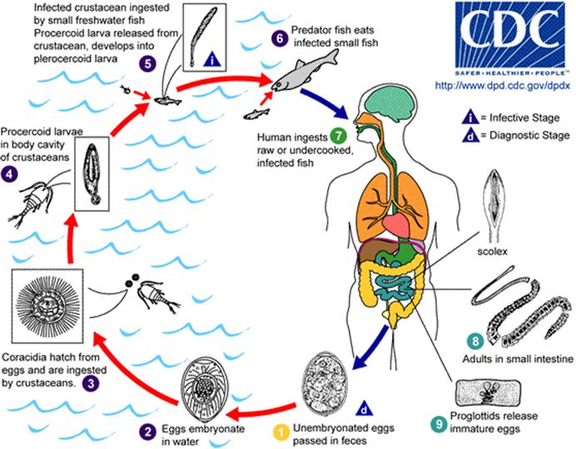
Parasite life stage and type of hosts
Cestode: Diphyllobotrium latum
Trematode: O. viverrini
Notes:
When it comes to parasites, we also need to have a range of additional descriptors, such as the life stage under study or the host type. . Many parasites, have complex life cycles, the term employed for the different stages differ depending on the type of parasites. For cestodes for example we have adults that infect the definitive host, then eggs that mature in coracidia in the environment, and procercoids and plerocercoids that infect intermdiate hosts. For trematodes, we can differentiate adults in definitive hosts, eggs that release infective miracidia in the environment, sporocystes and rediae are in the intermediate host, cercariae are released in the environment and metacercariae develop in the second intermediate host.

Slide 20
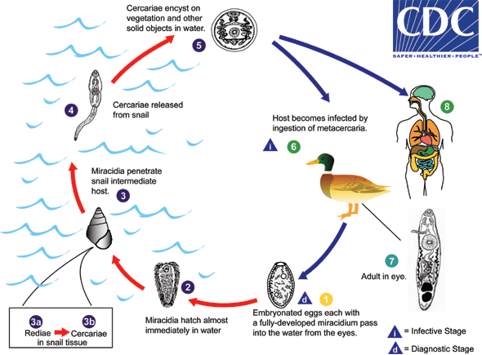
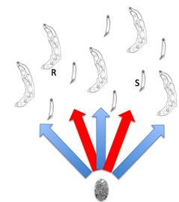
Clades
Reproductive individuals produce cercariae
Non-reproductive soldiers rediae
A social parasite Philophtalmus
Notes:
Some parasites are social, such as the trematode Philophtalmus : when infecting the snail intermediate host, some individuals are reproducers and will produce cercariae whereas other are non-reproductive soldiers rediae protect the colony by attacking other parasites.

Slide 21
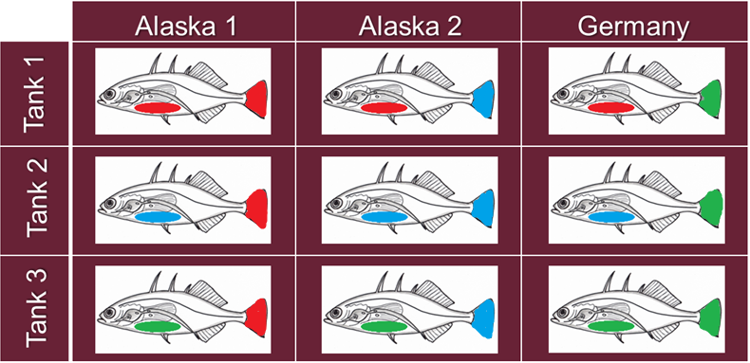
Special cases: experimental infections
Three populations of Hosts and corresponding parasites
G. aculeatus Hosts
3 families
3 families
3 families
3 families
S. solidus Parasites
3 families
3 families
Geographic origin genotype family relationship
Notes:
In laboratory conditions, we perform experimental infections and often use what we call cross-infections, to study the evolution of the host defenses and parasite virulence. For example here, we have completed a complete cross experimental infection with fish and parasites from 2 closely located Alaskan lakes and with fish and parasites from Europe.
And each parasite population has been presented to the three populations of fish.
each fish population has been exposed to the three different populations of parasites. For each population, we used fish or parasites from 3 different families, meaning that all individuals come from the same pair of parents.
It means that to tets the role of host or parasite origin on the composition of host and parasite microbiomes, for each host and parasite package, we must indicate the geographic origin of the parent and the family relationship of the individuals used for experimental infection

Slide 22
S. solidus local adaptation to microbes
Greater infection success during sympatric than allopatric interactions at both the local (lakes) and continental levels.
Local adaptation of S. solidus to its host
14/56
7/48
0/60
9/56
14/48
8/60
4/56
9/48
15/60
Exposure Infection total weight organ weight organ appearance Infection success
Notes:
Here are the results of such cross experimental design in term of infection success. The numbers indicate the number of infected fish and the total number of exposed fish. The size of the fish drawn is proportional to the infection success. It clearly shows a higher infection success in sympatric interaction, when fish and parasite come from the same location, rather than in allopatric interaction suggesting that the parasites are more infectious when exposed to local fish whereas fish are generally quite resistant. When looking at other phenotypic measures, results can vary greatly. For example, the size of the parasite was much larger when they infected fish from europe than from alaska.
To compare the microbiome of fish exposed or not to the parasite, and successfully infected or not,, and correlate it with the fish phenotype, we need to record many additional information.

Slide 23


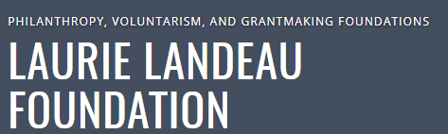

Acknowledgements
Collaborators on the PMP
Daniel Bolnick
Seth Bordenstein
Paul Brindley
Edward Holmes
Joaquin Martinez Martinez
Anna Phillips
Robert poulin
Karyna Rosario
Dheilly lab student involved
Megan Hahn
1st Parasite Microbiome Project Workshop
January 2019
Notes:
This is clearly a work in progress and I would like to thank my collaborators for their enthusiasm in this project. The Eppley Foundation for research and the Laurie Landeau Foundation are currently supporting my research activities on S. solidus, and the Marsden Fund is supporting a collaborative project with Robert Poulin aiming at characterizing the role of microbes in parasite life history strategies. Finally Joaquin martinez martinez and I have obtained the support of the Gordon and Betty Moore Foundation to organize the first PMP workshop, aiming at writing a collaborative proposals to obtain funding and officially launch the PMP.

